Slide 1
AWS Cloud Foundations
Global Certification :
AWS Certified Cloud Practitioner (CLF-C02)

Slide 2
AWS cloud certifications
AWS cloud practitioner – Foundation
AWS Cloud Solutions Architect – Associate
AWS DevOps

Slide 3
AWS Certified Cloud Practitioner (CLF-C02) Exam Guide
The AWS Certified Cloud Practitioner (CLF-C02) exam is intended for individuals who can effectively demonstrate overall knowledge of the AWS Cloud, independent of a specific job role.
The target candidate should have knowledge in the following areas:
• AWS Cloud concepts
• Security and compliance in the AWS Cloud
• Core AWS services
• Economics of the AWS Cloud

Slide 4
Exam content
Response types :
There are two types of questions on the exam:
• Multiple choice: Has one correct response and three incorrect responses (distractors)
• Multiple response: Has two or more correct responses out of five or more response options

Slide 5
Exam results
The minimum passing score is 700 out of 1000

Slide 6
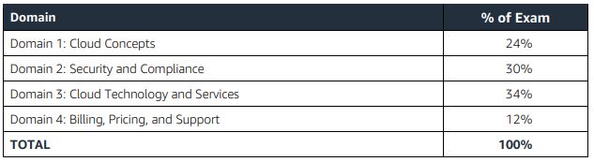
Content outline

Slide 7
Cloud Foundations
Top Cloud companies:
AWS
Microsoft Azure
GCP – Google Cloud Platform
Alibaba cloud
Oracle
IBM
Vmware etc.

Slide 8
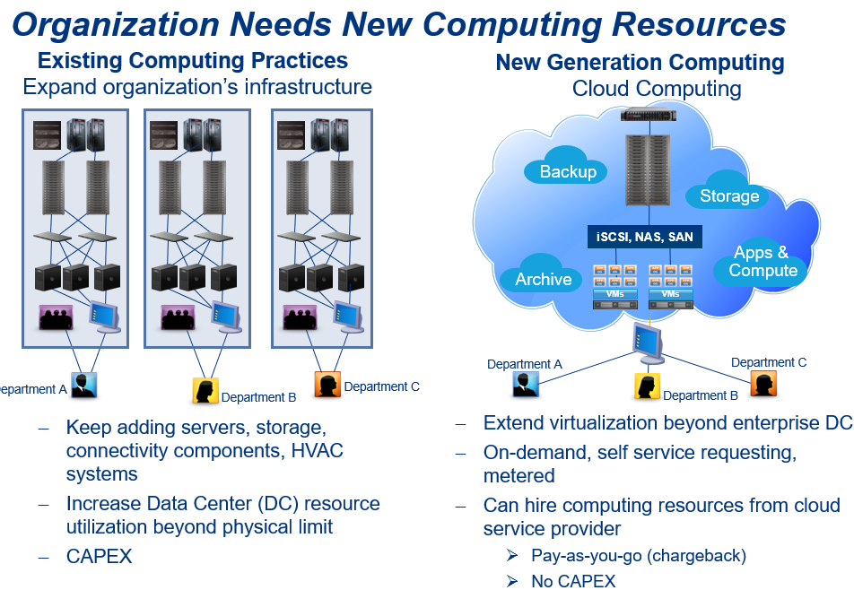

Slide 9
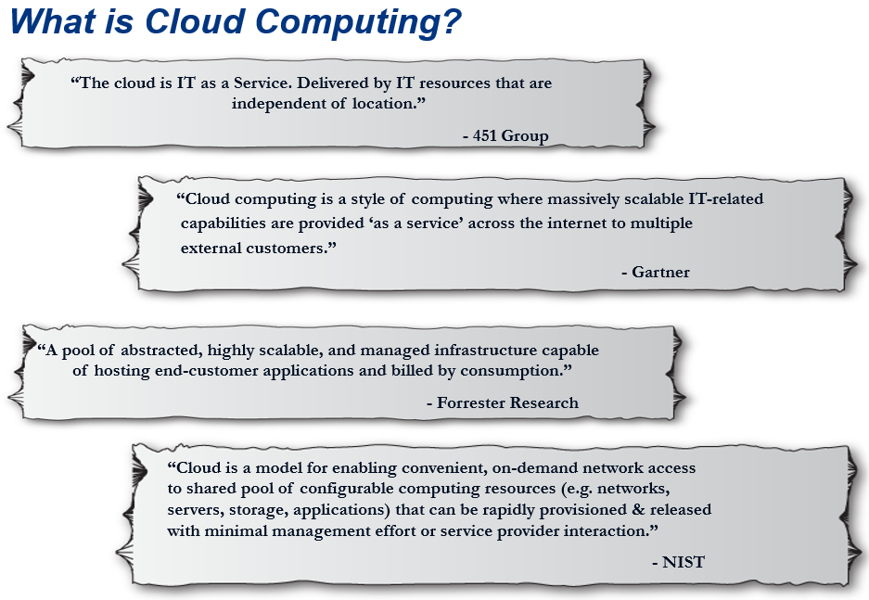

Slide 10
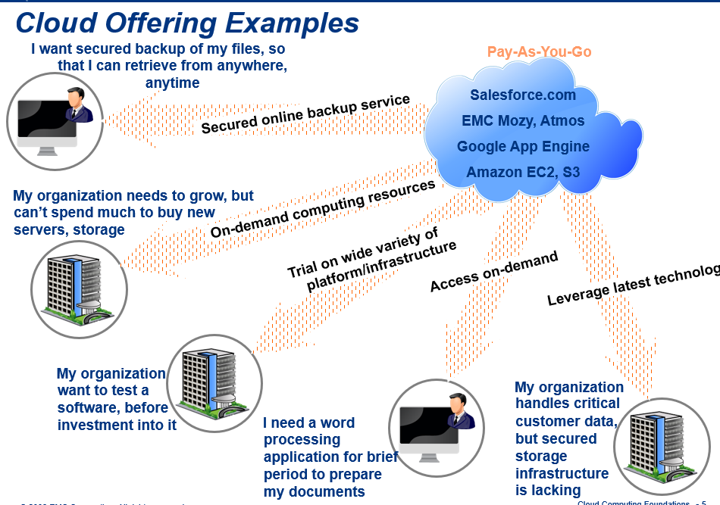

Slide 11
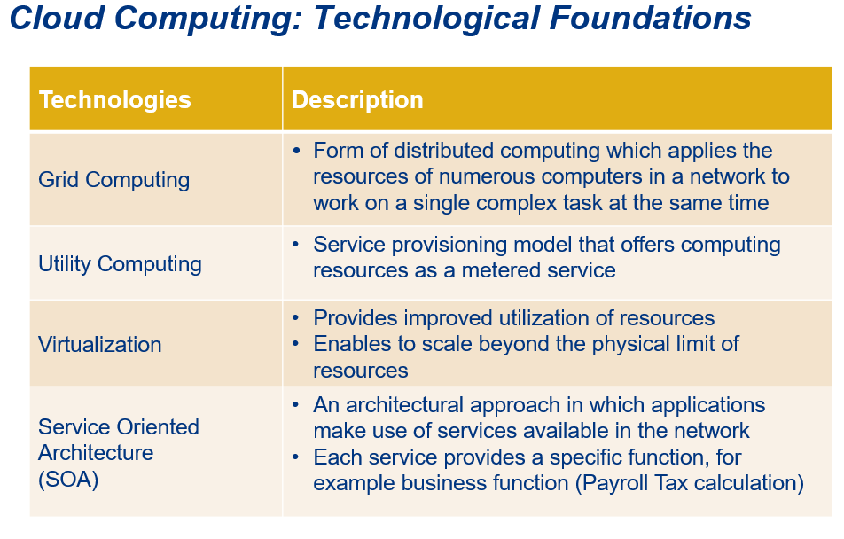

Slide 12
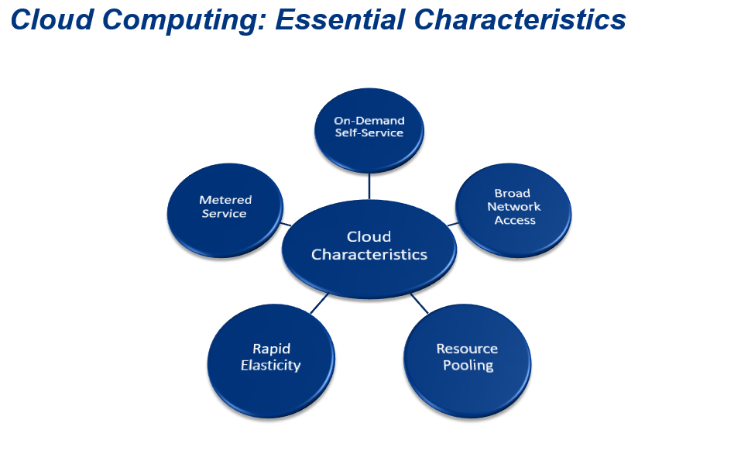

Slide 13
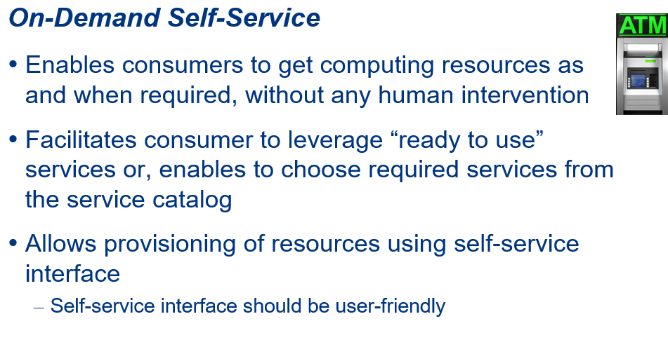

Slide 14
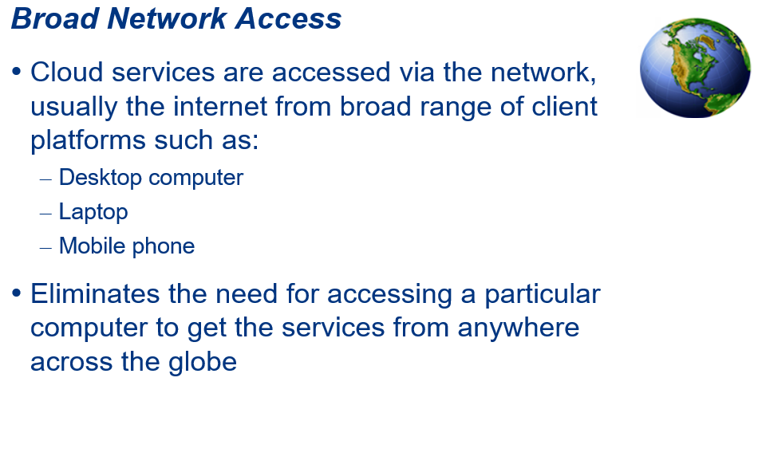

Slide 15
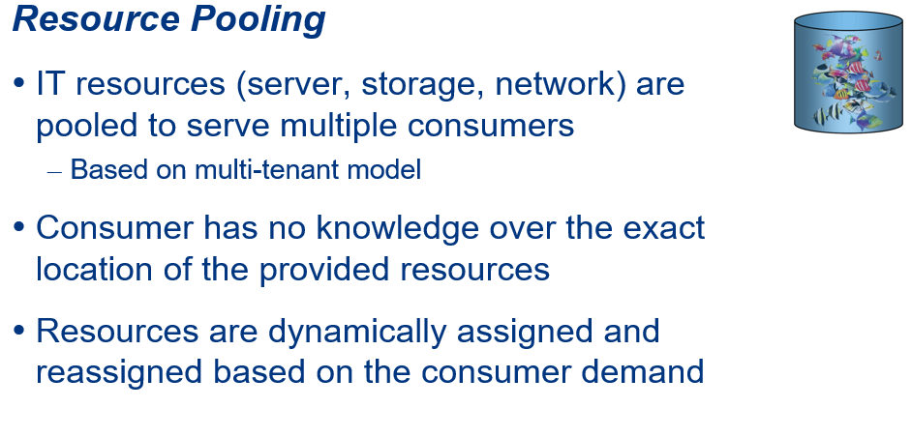

Slide 16
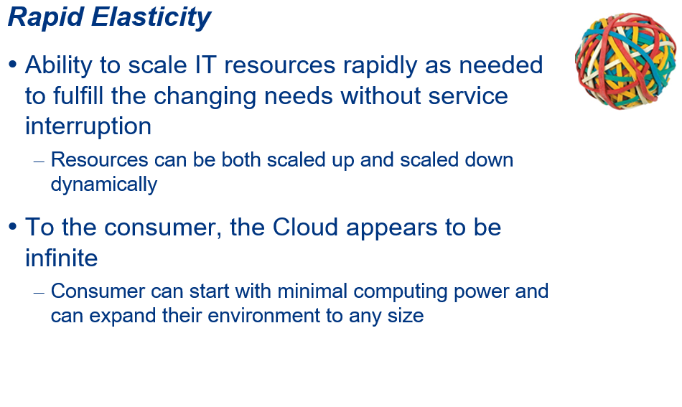

Slide 17
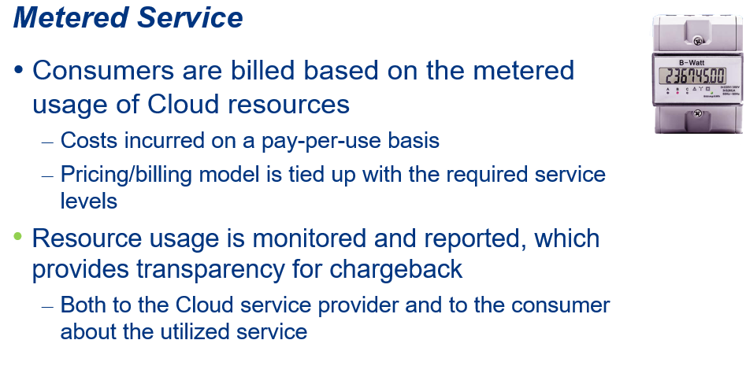

Slide 18
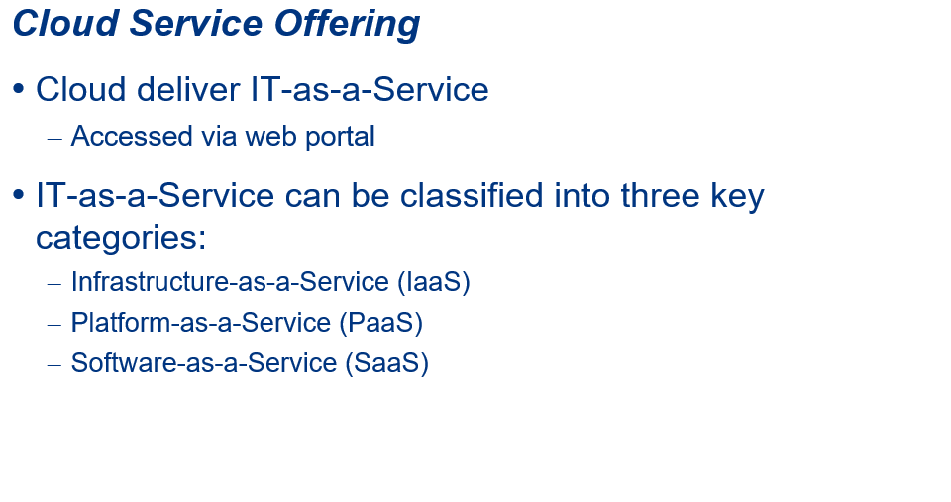

Slide 19
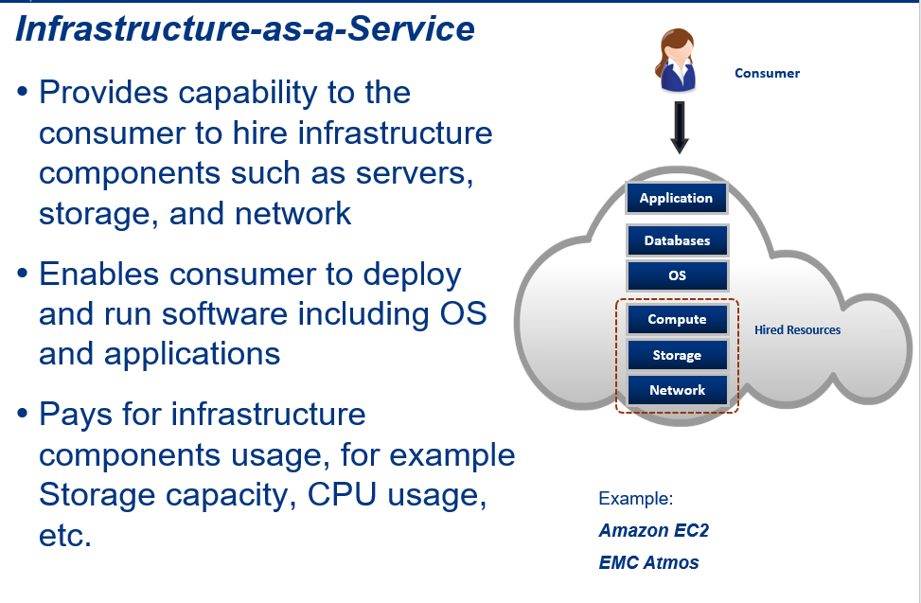

Slide 20
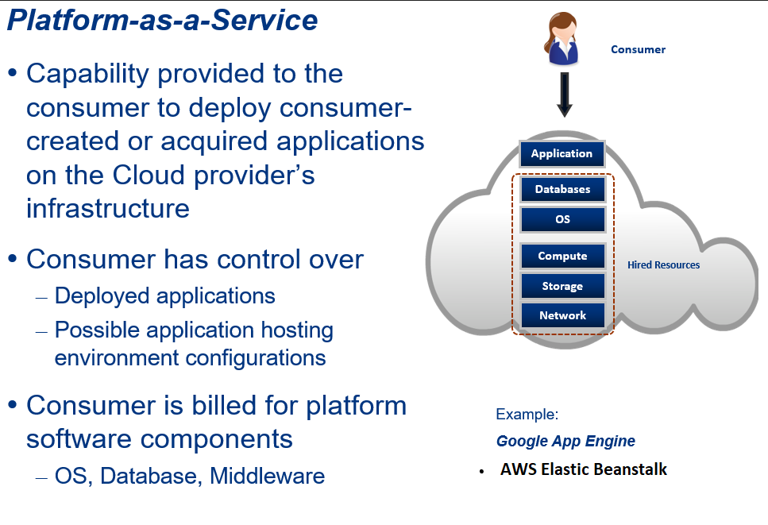

Slide 21
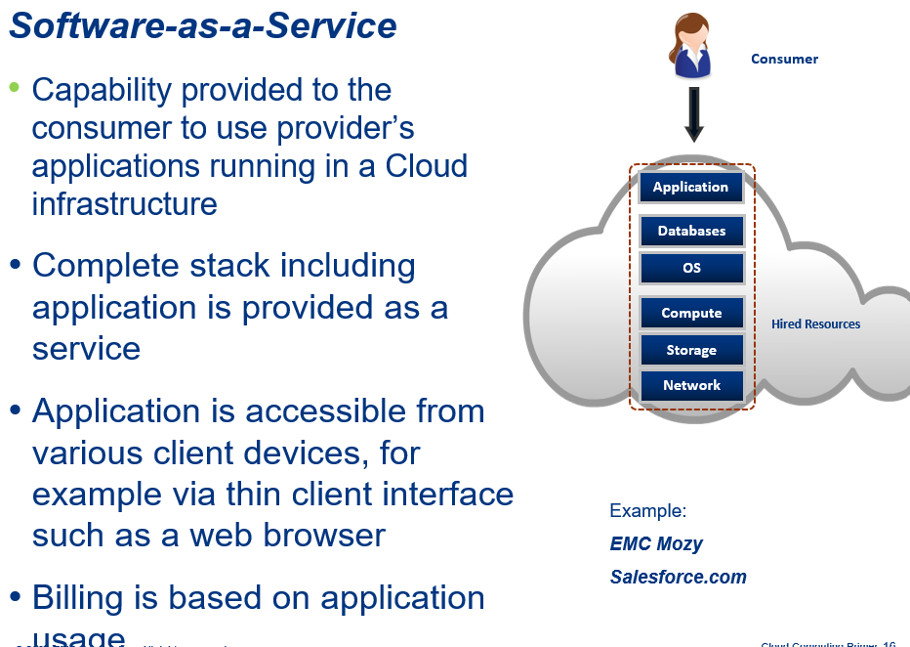

Slide 22
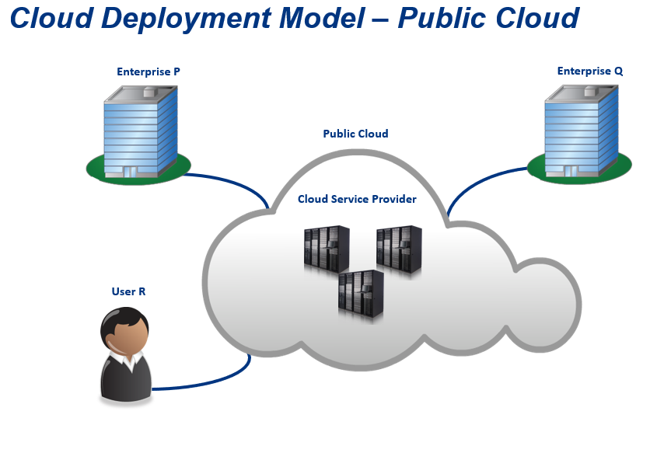

Slide 23
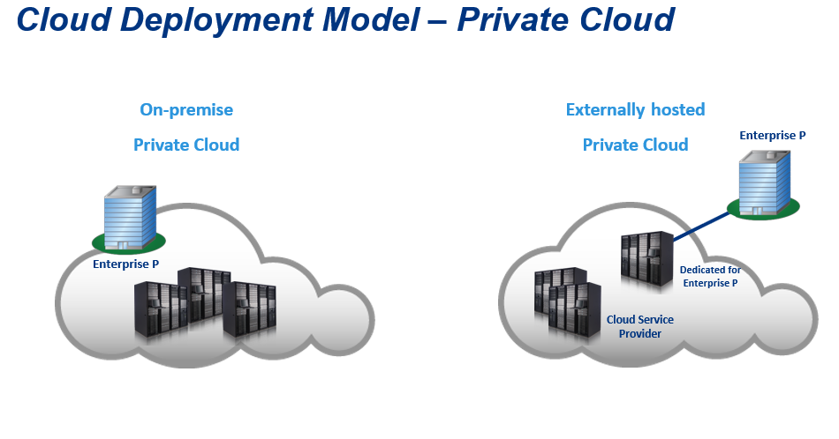

Slide 24
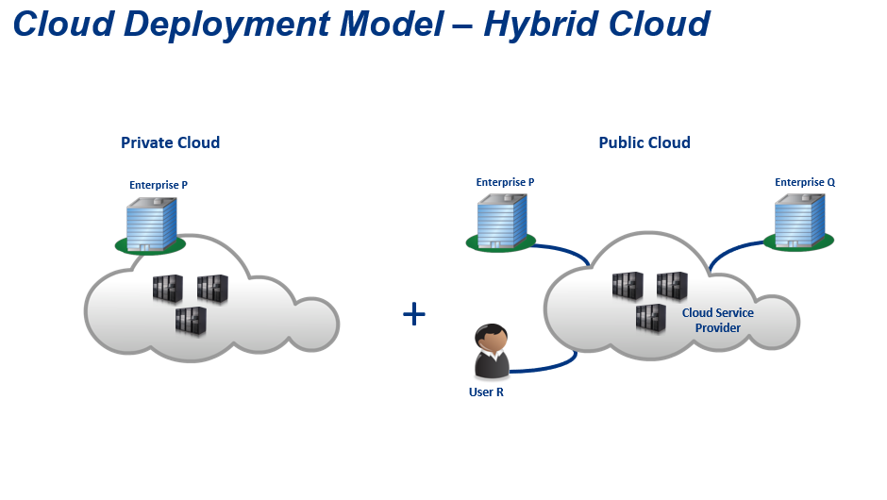

Slide 25
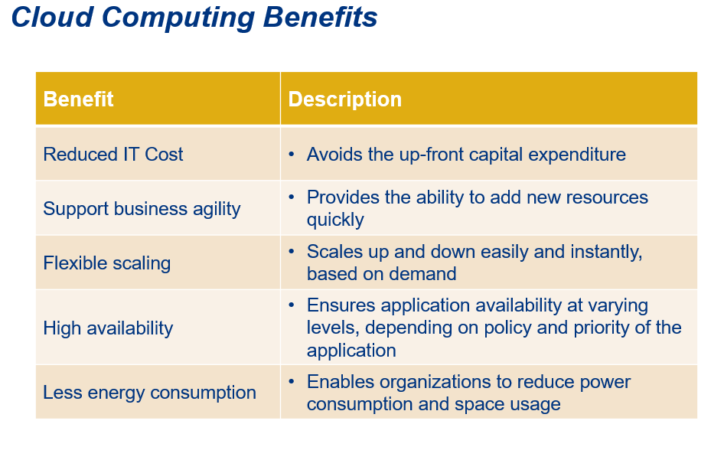

Slide 26
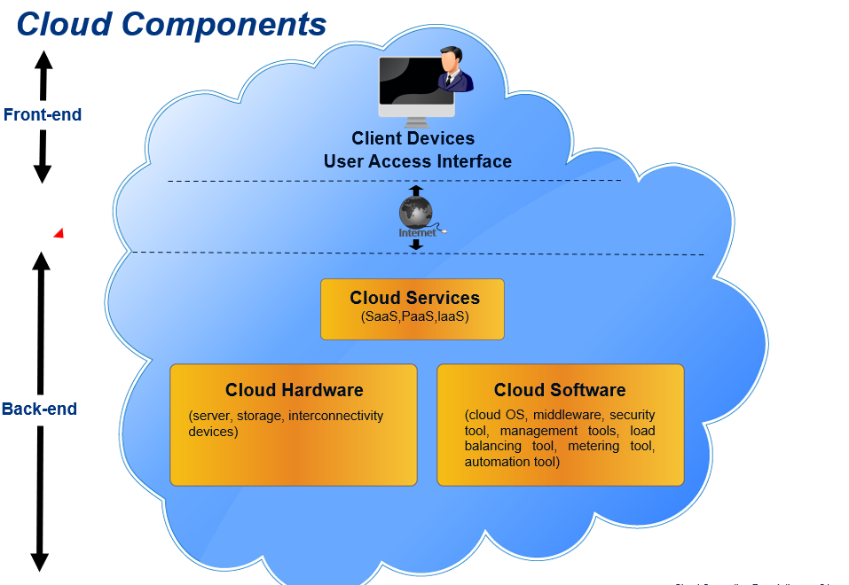

Slide 27
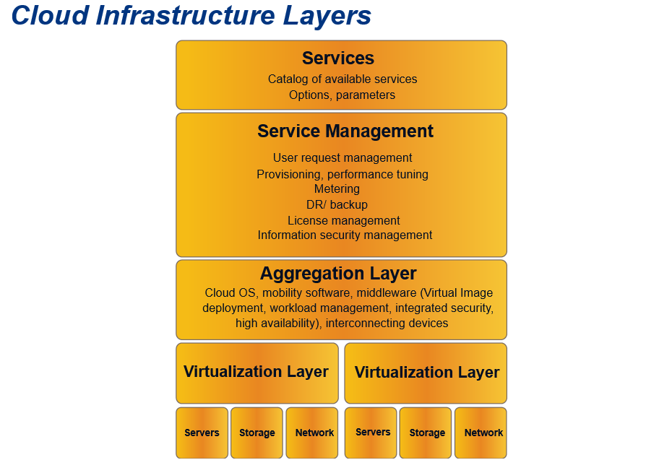

Slide 28
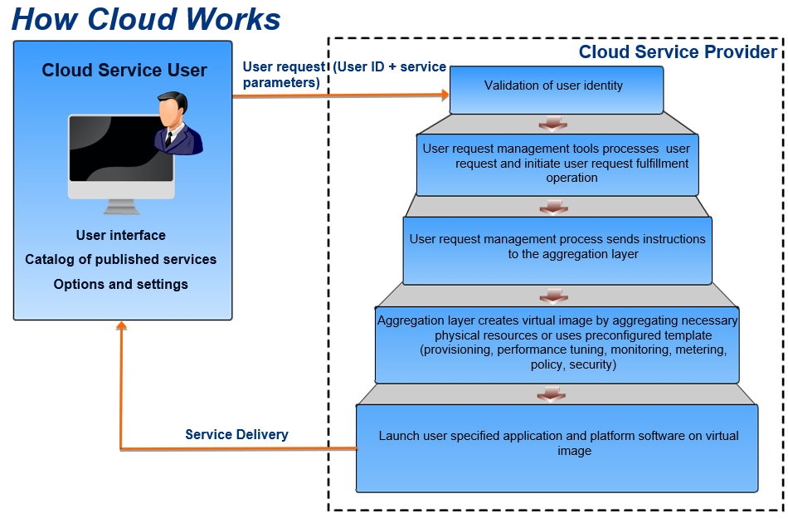

Slide 29
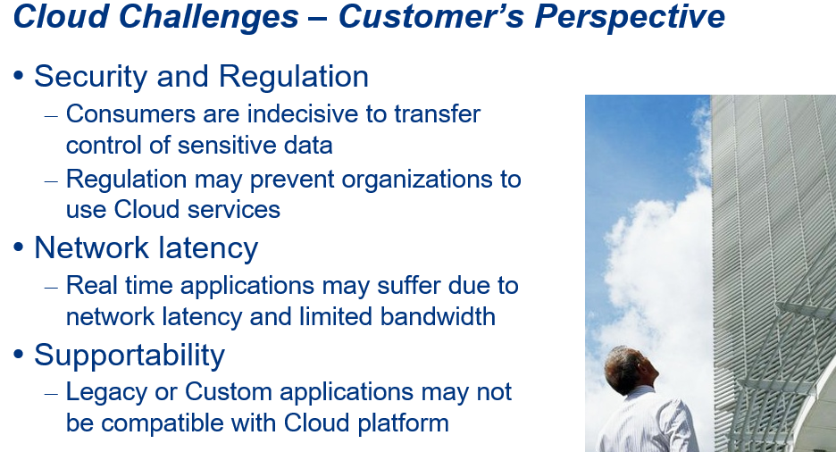

Slide 30
